Slide 1
Alarm Oracle
Luke Miller and Semir Hot

Slide 2
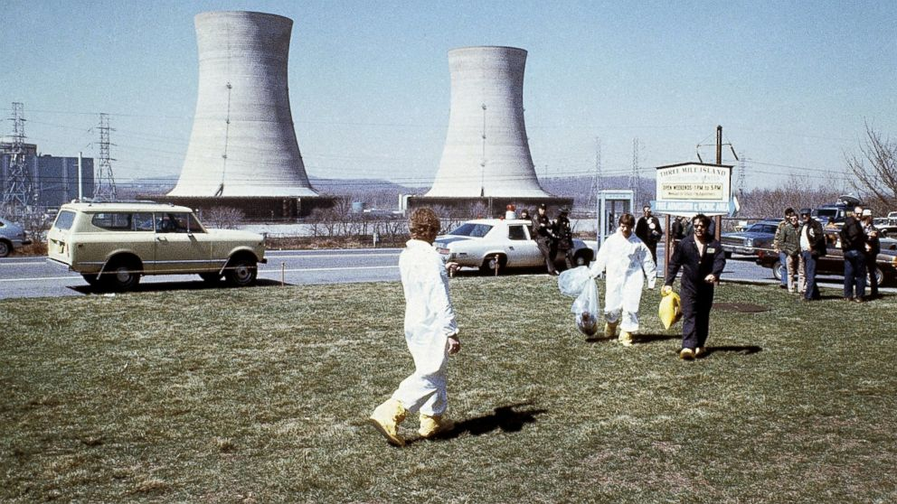
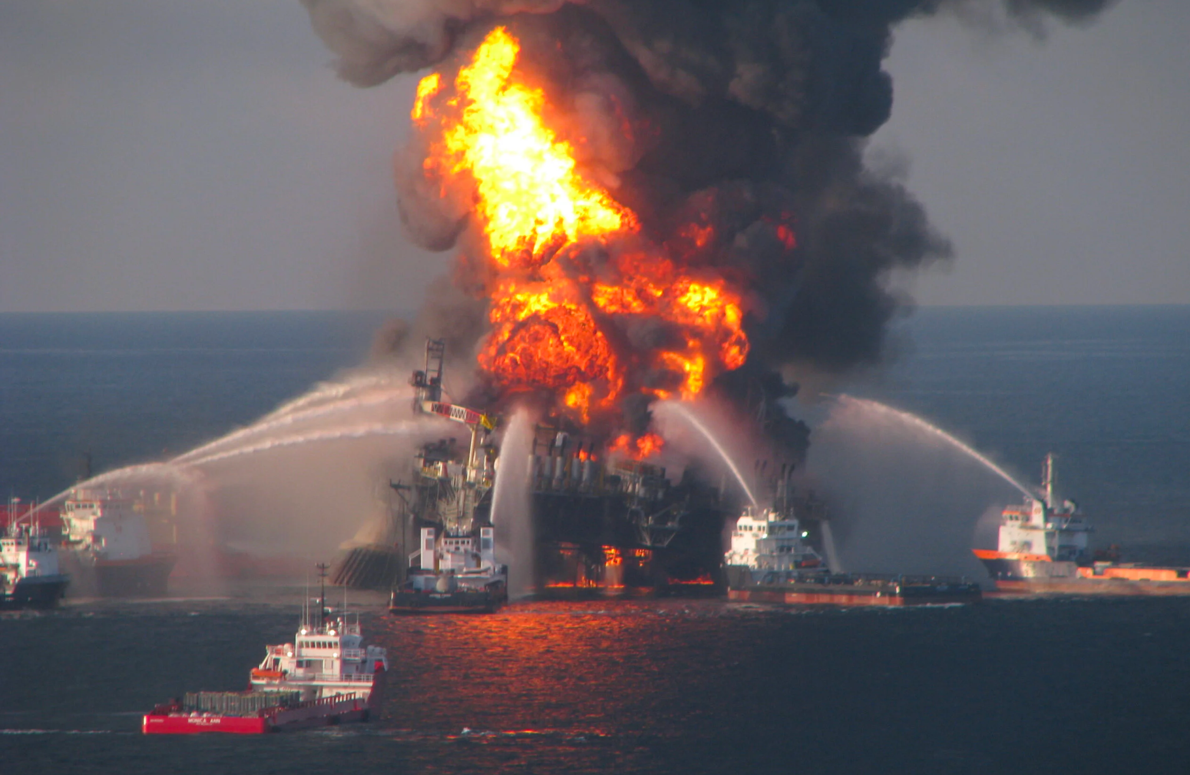
Motivation
Piper Alpha
3 Mile Island

Slide 3
Problem Statement
Program Overview
Alarm Oracle:
Unsupervised Graph Neural Network
Hawkes-process.
High Precision
Identifies Structures in Data
Finds Root Causes
Diagnoses Alarm Cascades

Slide 4
Data Description
Data Source
Based on real-world dataset from Huawei
Huawei data didn't provide a testable target
Generated data with matching distribution
Built Device Topology, probabilistic alarms
Alarm log training set generated

Slide 5
Algorithm
Input: Device topology, Alarm logs, max hops, other hyperparameters
Preprocesses alarm logs using hill climbing to create a causal matrix, our predicted value.

Slide 6
Algorithm
Decay effects with timestamps & k-hops.
Expectation Maximization to refine parameters
Evaluates model's performance with a likelihood score
Uses AIC or BIC to guide model selection

Slide 7
Results
Performance Metrics
Attained 100% precision
50% of potential alarm cascades identified
Some Cascades not represented by Data.
O(n) reduced by Factor of 7 by Optimization

Slide 8
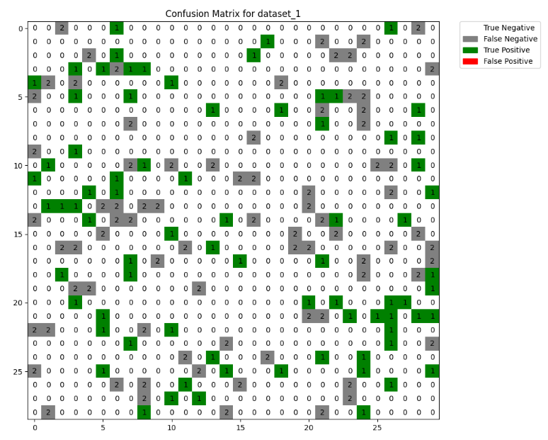
1 of 4 similar results

Slide 9
Future Directions
Add validation metrics
Incorporate Prior Information
Add verified causal structures in training
Iteratively increase performance
Adapt to real-time environment
Optimize data preprocessing.
Streamline algorithmic efficiency

Slide 10
Thanks
Luke Miller
ljmbm5@umsystem.edu
Semir Hot
shy8h@umsystem.edu

